Slide 1
Parish Survey Analysis
October 2021

Slide 2
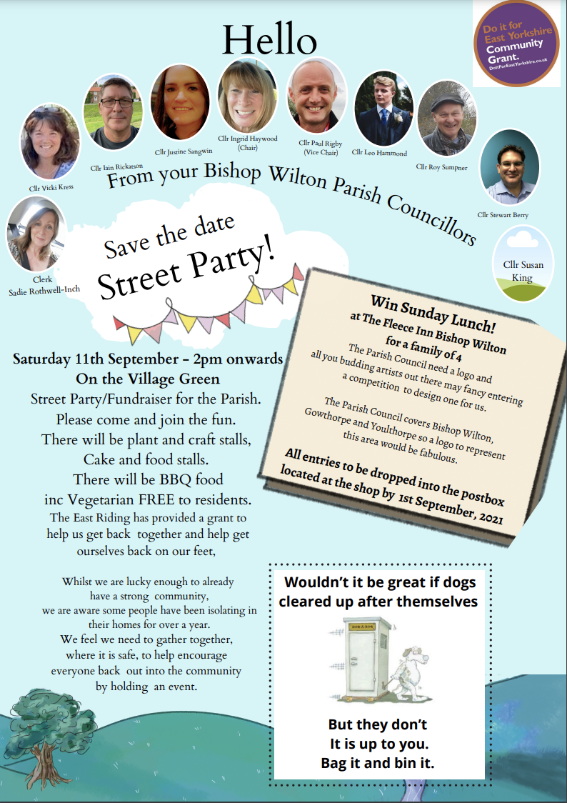
About the survey
Methodology:
210 printed surveys distributed to homes in Parish
Surveys delivered to the Community Shop
Survey period: 18th August to 12th September 2021
Response:
76 responses
36% response rate – good engagement
Sample considered representative of the Parish

Slide 3
Conclusions
People want to receive communication with us in the Parish Pump (94%) and by an annual posted newsletter (73%).
People want to contact the council by calling a Councillor (78%) or emailing the Clerk (66%).
70% would like the bus stop waiting area extended – 67% would like additional funding found.
35% think there is an issue with speeding and would volunteer to help.
83% want the green cut three times per year – roughly 50/50 on late for pollinators and beck-side uncut. 64% want bed cleared.

Slide 4
Question Analysis

Slide 5
How would you like to receive this communication?
Parish Pump clear winner
Newsletter and website positive
Facebook is 50/50
Email less popular

Slide 6
Do you know how to contact us?
Phone and email are how people want to contact us.
Less than half access the website.
Just over a third want a Facebook page.

Slide 7
Bus Stop - Extension and Funding
Would you like to see the waiting area extended?
Would you like to see additional funding to be obtained?

Slide 8
If you have any concerns about speeding through the Parish, would you be willing to volunteer for the ‘Community Speed Watch’?
35% think there is a speeding problem AND would volunteer.
We do not know how many think there is a speeding problem, but wouldn’t volunteer.

Slide 9
Cutting the village green
83% want the beck cut three times per year
64% want it cleared each time
48% would prefer the three cuts to be later
55% want want whole green cut

